Slide 1
SMALL BUSINESS OWNERS ANALYSIS ACROSS THE US
Jorge Maspons
Mariena Alvarez
Paulo Cortez
Data Analytics Bootcamp

Slide 2
“Small business are the backbone of our economy”

Slide 3

Source: Last Week Tonight/Youtube

Slide 4
How are different genders and ethnicities distributed across small businesses in the United States?

Slide 5
DATA ANALYSIS PROCESS
Data Understanding
Business Understanding
Reporting
Data Preparation
Data Evaluation
Data Modelling

Slide 6
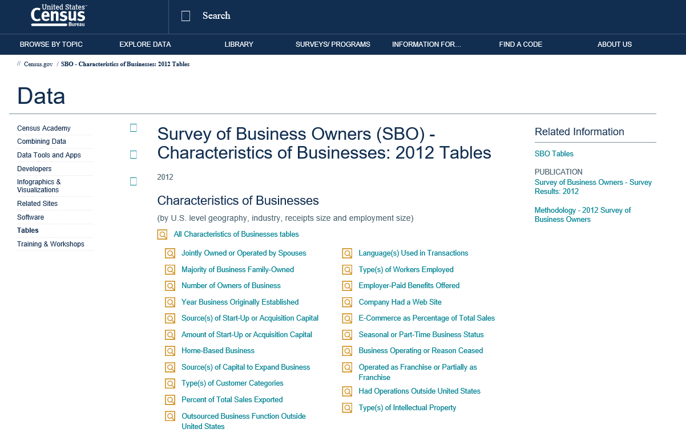
DATA UNDERSTANDING

Slide 7
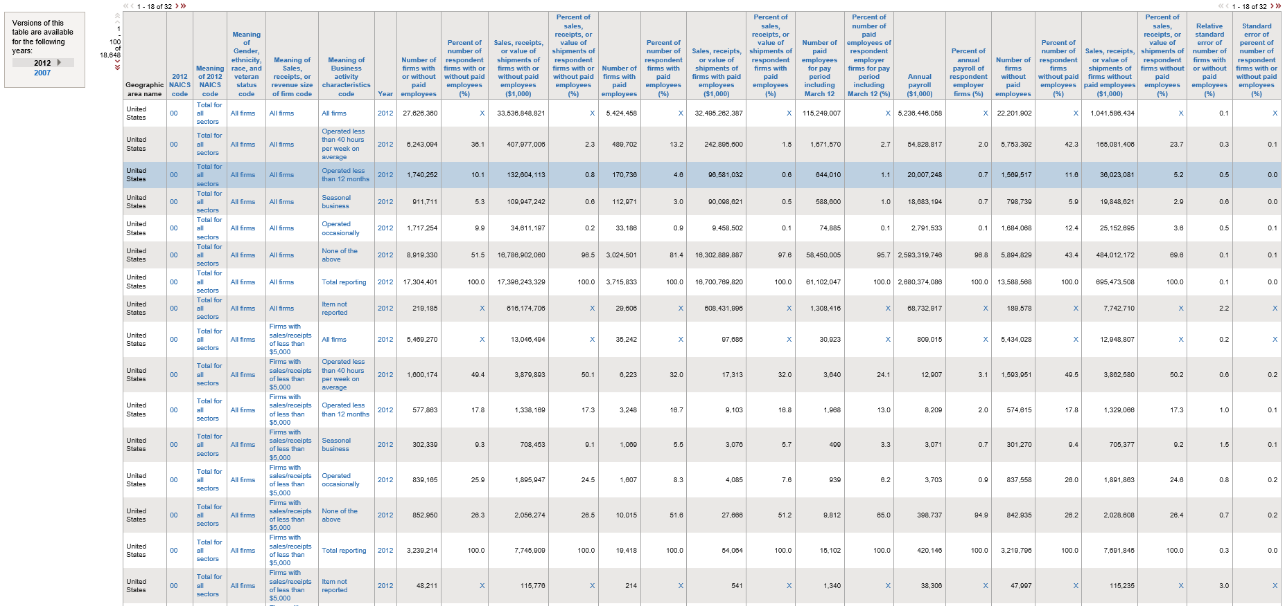
DATA UNDERSTANDING
21 DIFFERENT INDUSTRIES CATEGORIES
102 DIFFERENT GENDER/ETHNICITY CATEGORIES

Slide 8
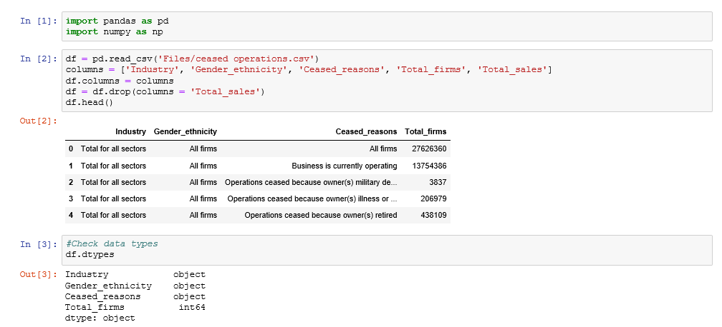
DATA PREPARATION
Interesting Facts

Slide 9
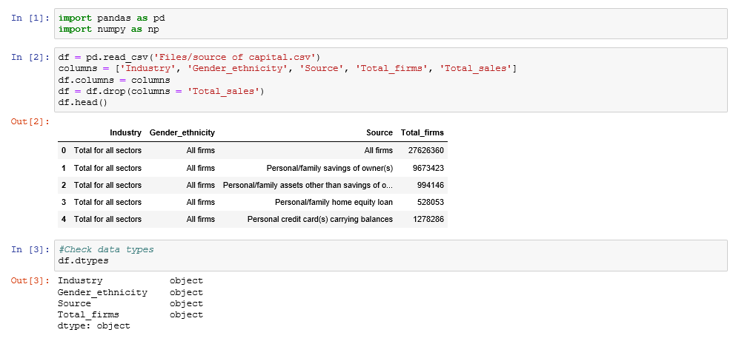
DATA PREPARATION
Interesting Facts

Slide 10
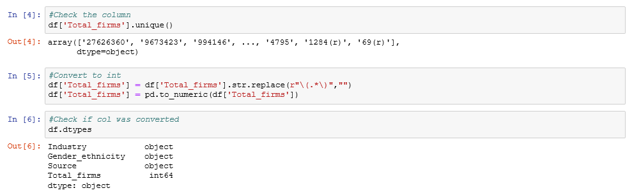
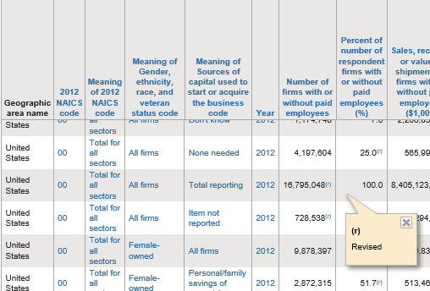
DATA PREPARATION
Interesting Facts

Slide 11
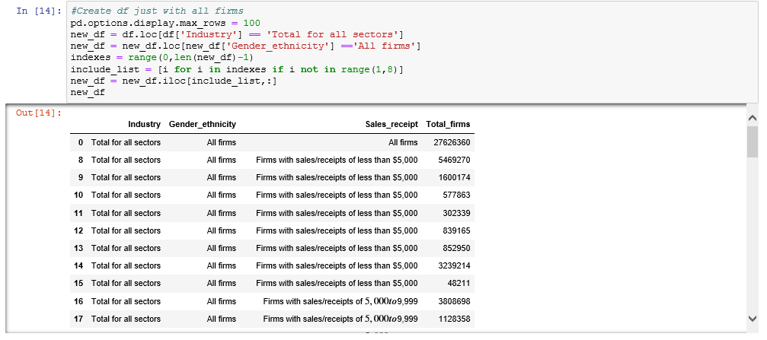
DATA PREPARATION
Interesting Facts
Thank you Mike!
1

Slide 12
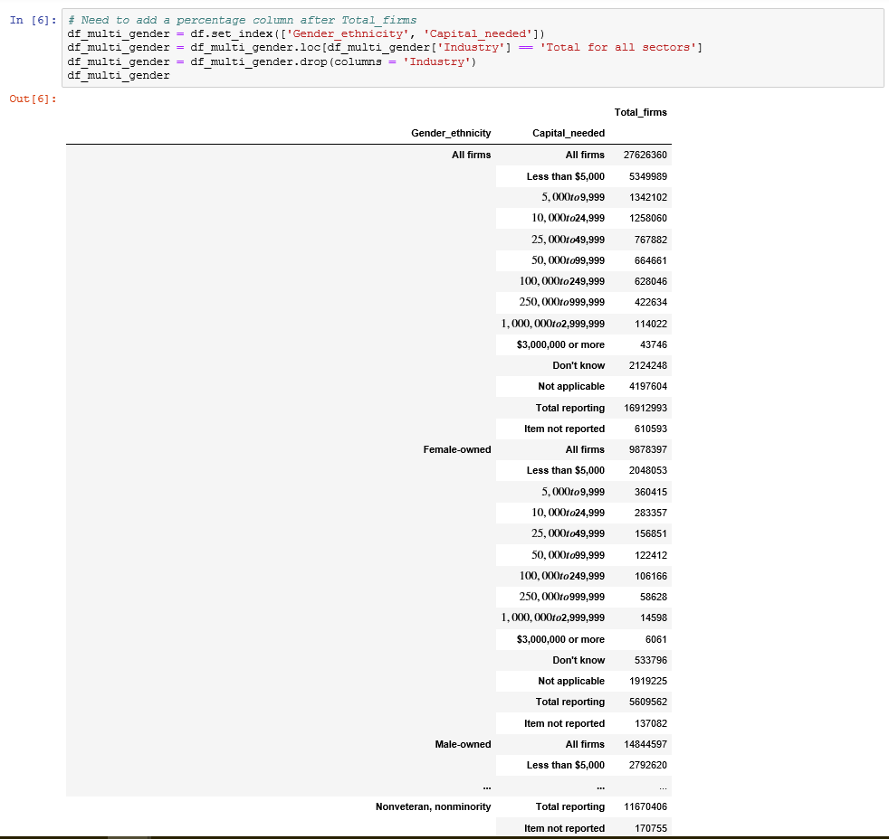
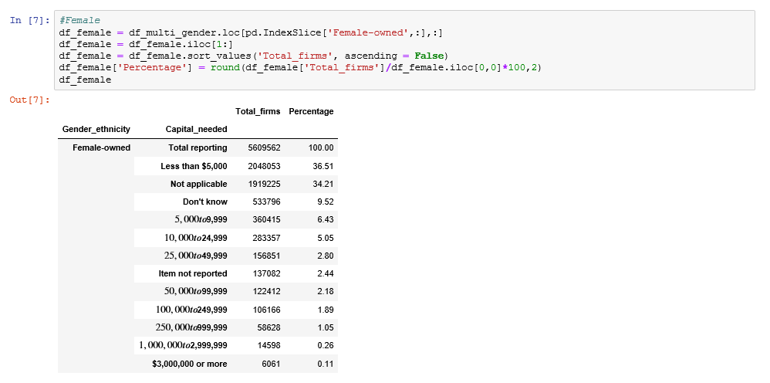
DATA MODELLING
Interesting Facts
Same view as used to
Slice per industry type

Slide 13
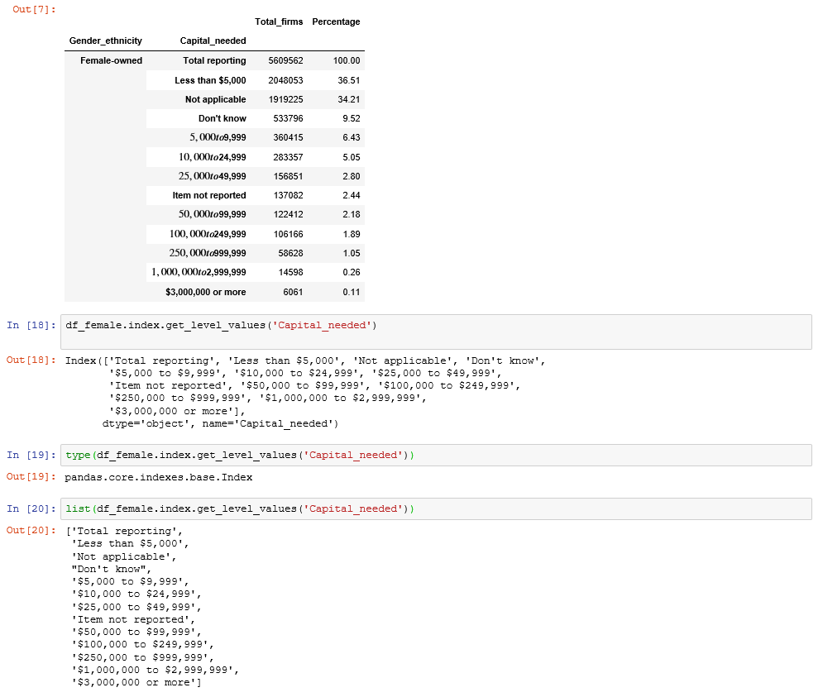
DATA MODELLING
Interesting Facts
Percentage column created to be compared to other genders and ethnicities
To be used when creating the plots

Slide 14
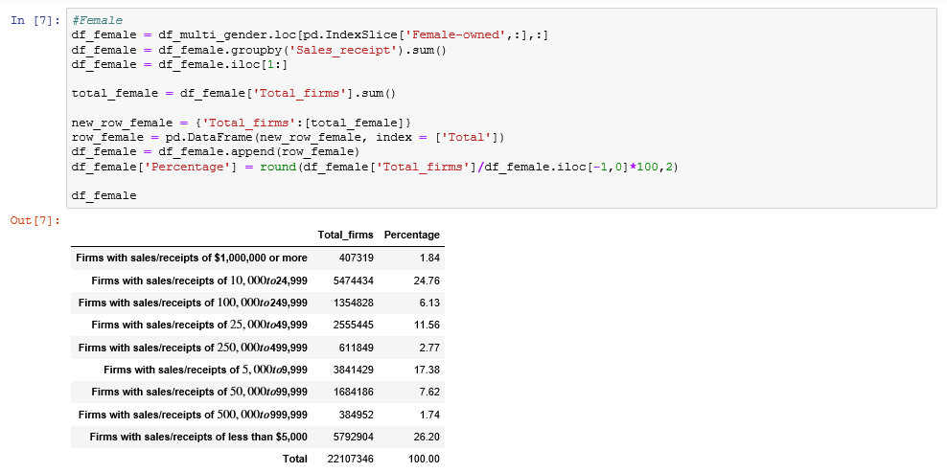
DATA MODELLING
Interesting Facts
Manipulating data to be merged

Slide 15
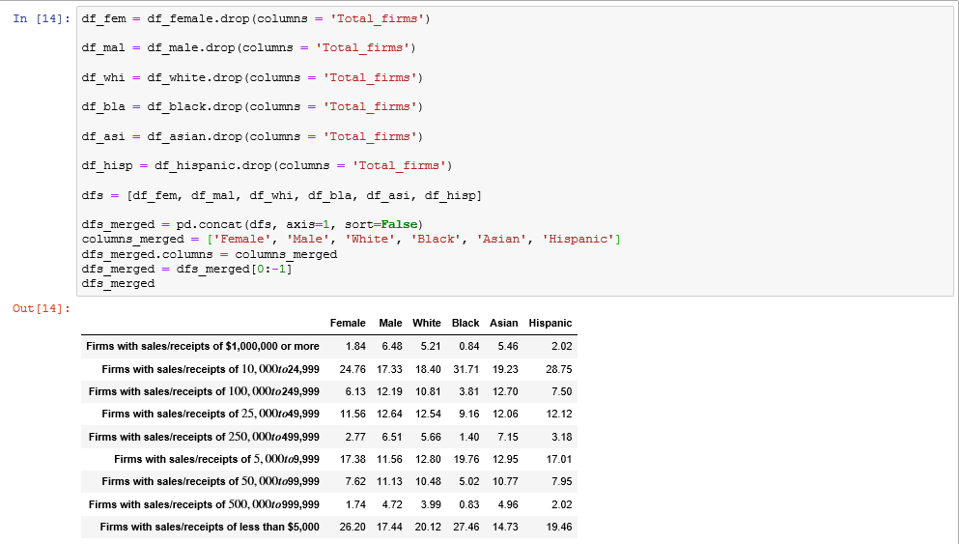
DATA MODELLING
Interesting Facts
Merging data to create plots

Slide 16
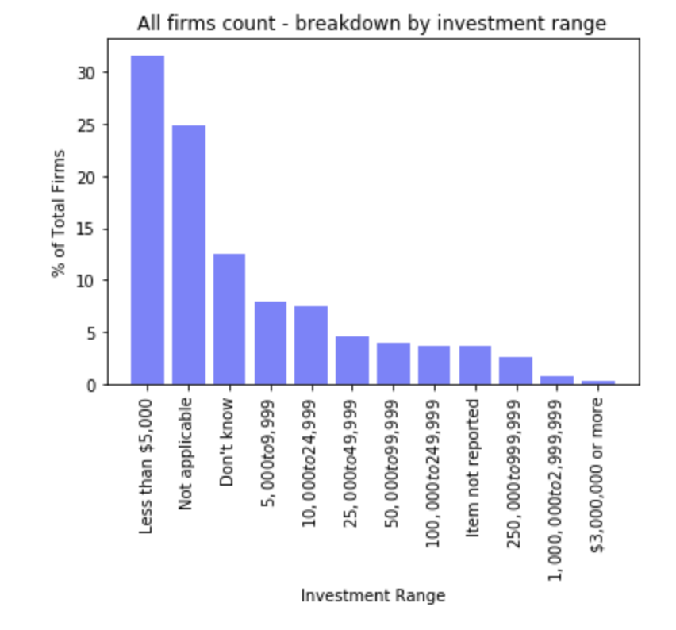
Amount of capital required for business ownership in the U.S.
REPORTING
Interesting Facts
Almost 90% of SBOs founded / acquired a business with <$50k

Slide 17
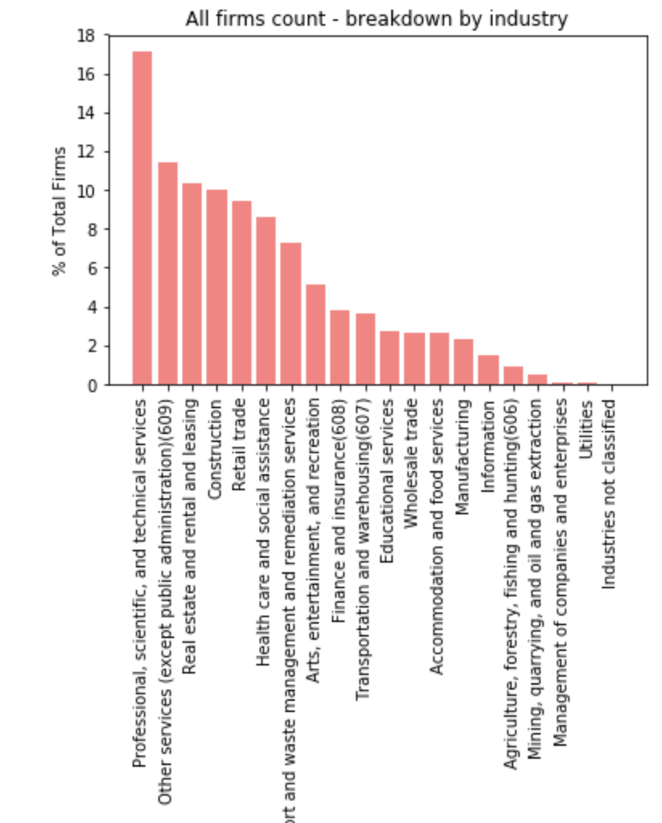
Most popular industries for U.S. small businesses
REPORTING
Interesting Facts
Top 5 industries (~60%): Professional & Other services, Real estate, Construction, and Retail

Slide 18
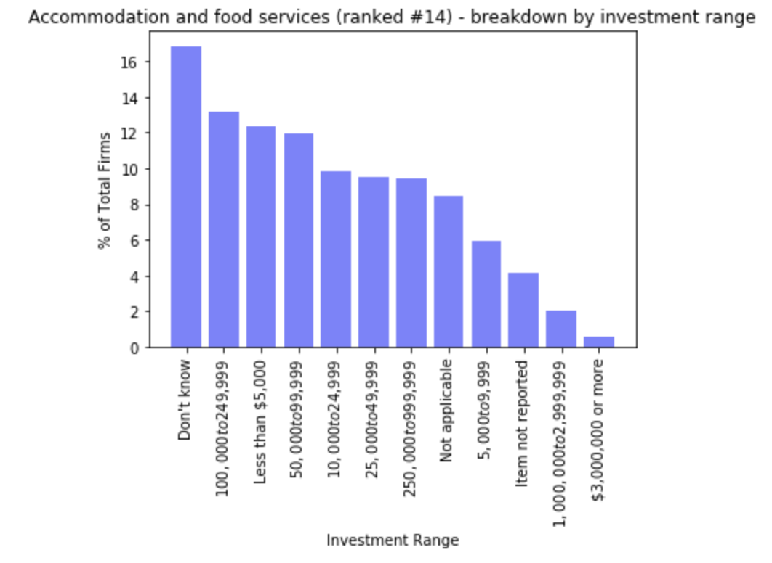
Industries characterized for high capital requirements
REPORTING
Interesting Facts
~1/3 of SBOs invested >$50k to enter into: Accommodation & food services, and Real estate

Slide 19
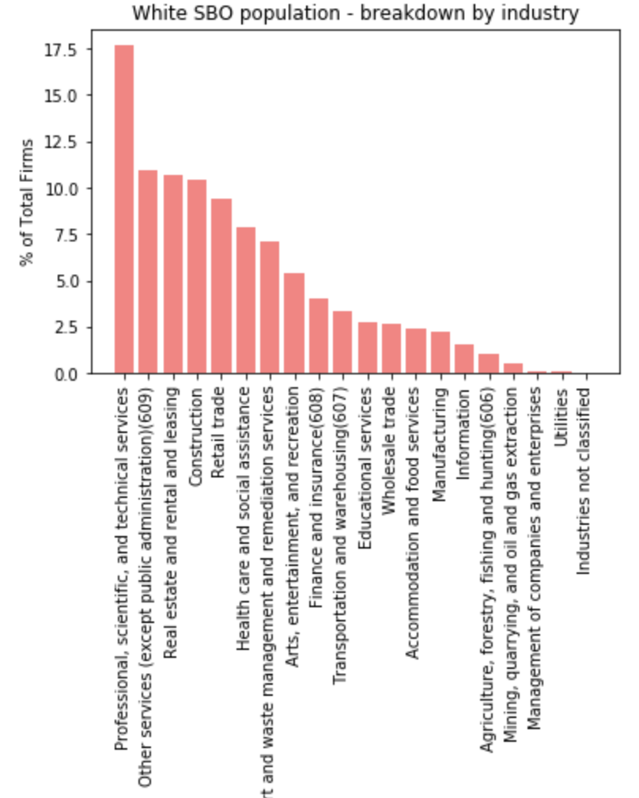
Influence of ethnicity in industry selection
REPORTING
Interesting Facts
Whites have > relative % in Real estate; Asians in Retail Accommodation / Food; African Americans in Health care services; Other minorities in Construction

Slide 20
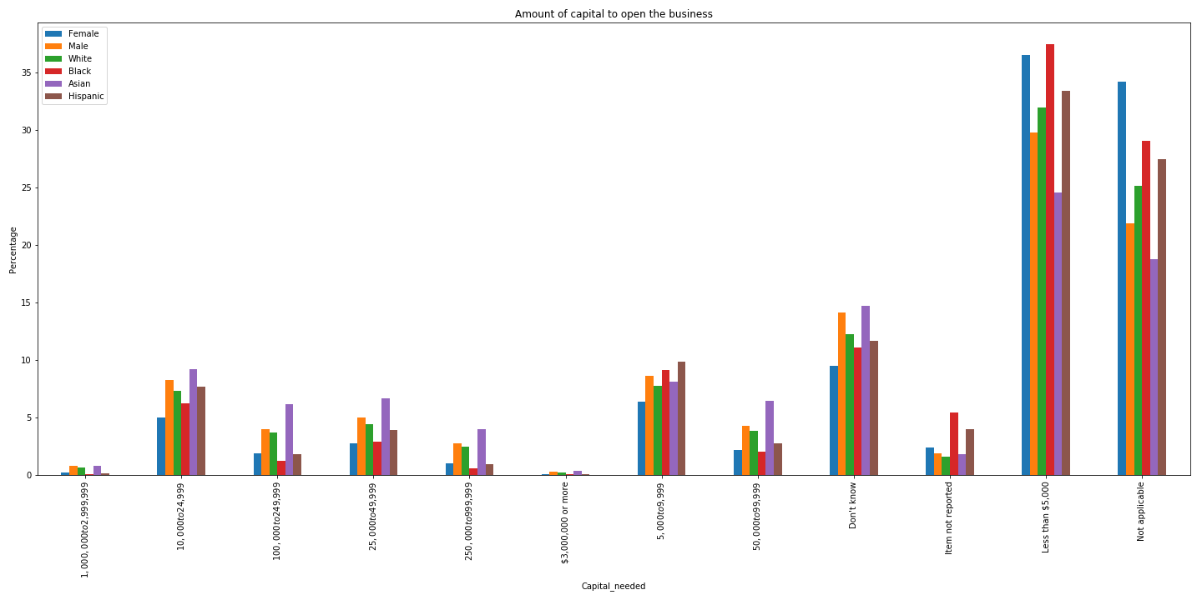
Influence of ethnicity in investment range
REPORTING
Interesting Facts
Asians make higher initial investments compared to other ethnicity groups; partly industry selection, partly other factors

Slide 21
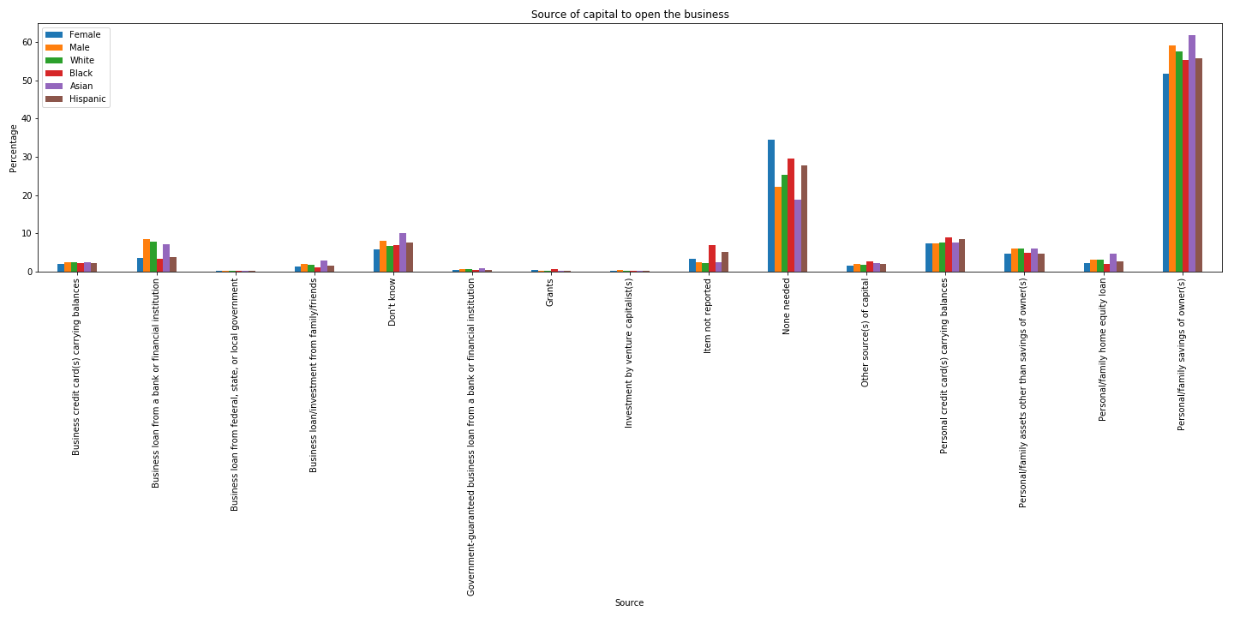
Common sources of capital to finance acquisitions/start-ups
REPORTING
Interesting Facts
Personal/family savings are the key source of capital for SBOs (across gender and ethnicities)

Slide 22
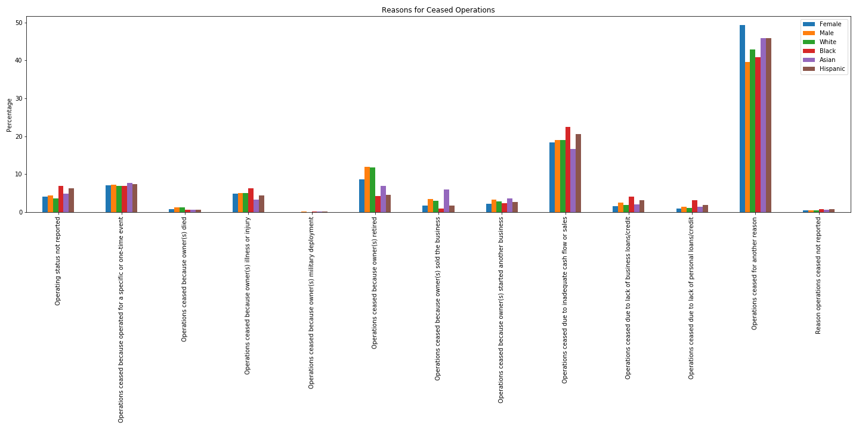
Primary reasons for business ceasing operations
REPORTING
Interesting Facts
Lack of cash flow and retirement are the two reasons for ~1/3 of all ceased firms

Slide 23
NEXT STEPS
Topics for further study
Analysis across datasets to search for patterns
Multiple sources of data (“no single source of truth”)
Compare analysis results by region/states
Access to up-to-date information (API requests)

